Slide 1
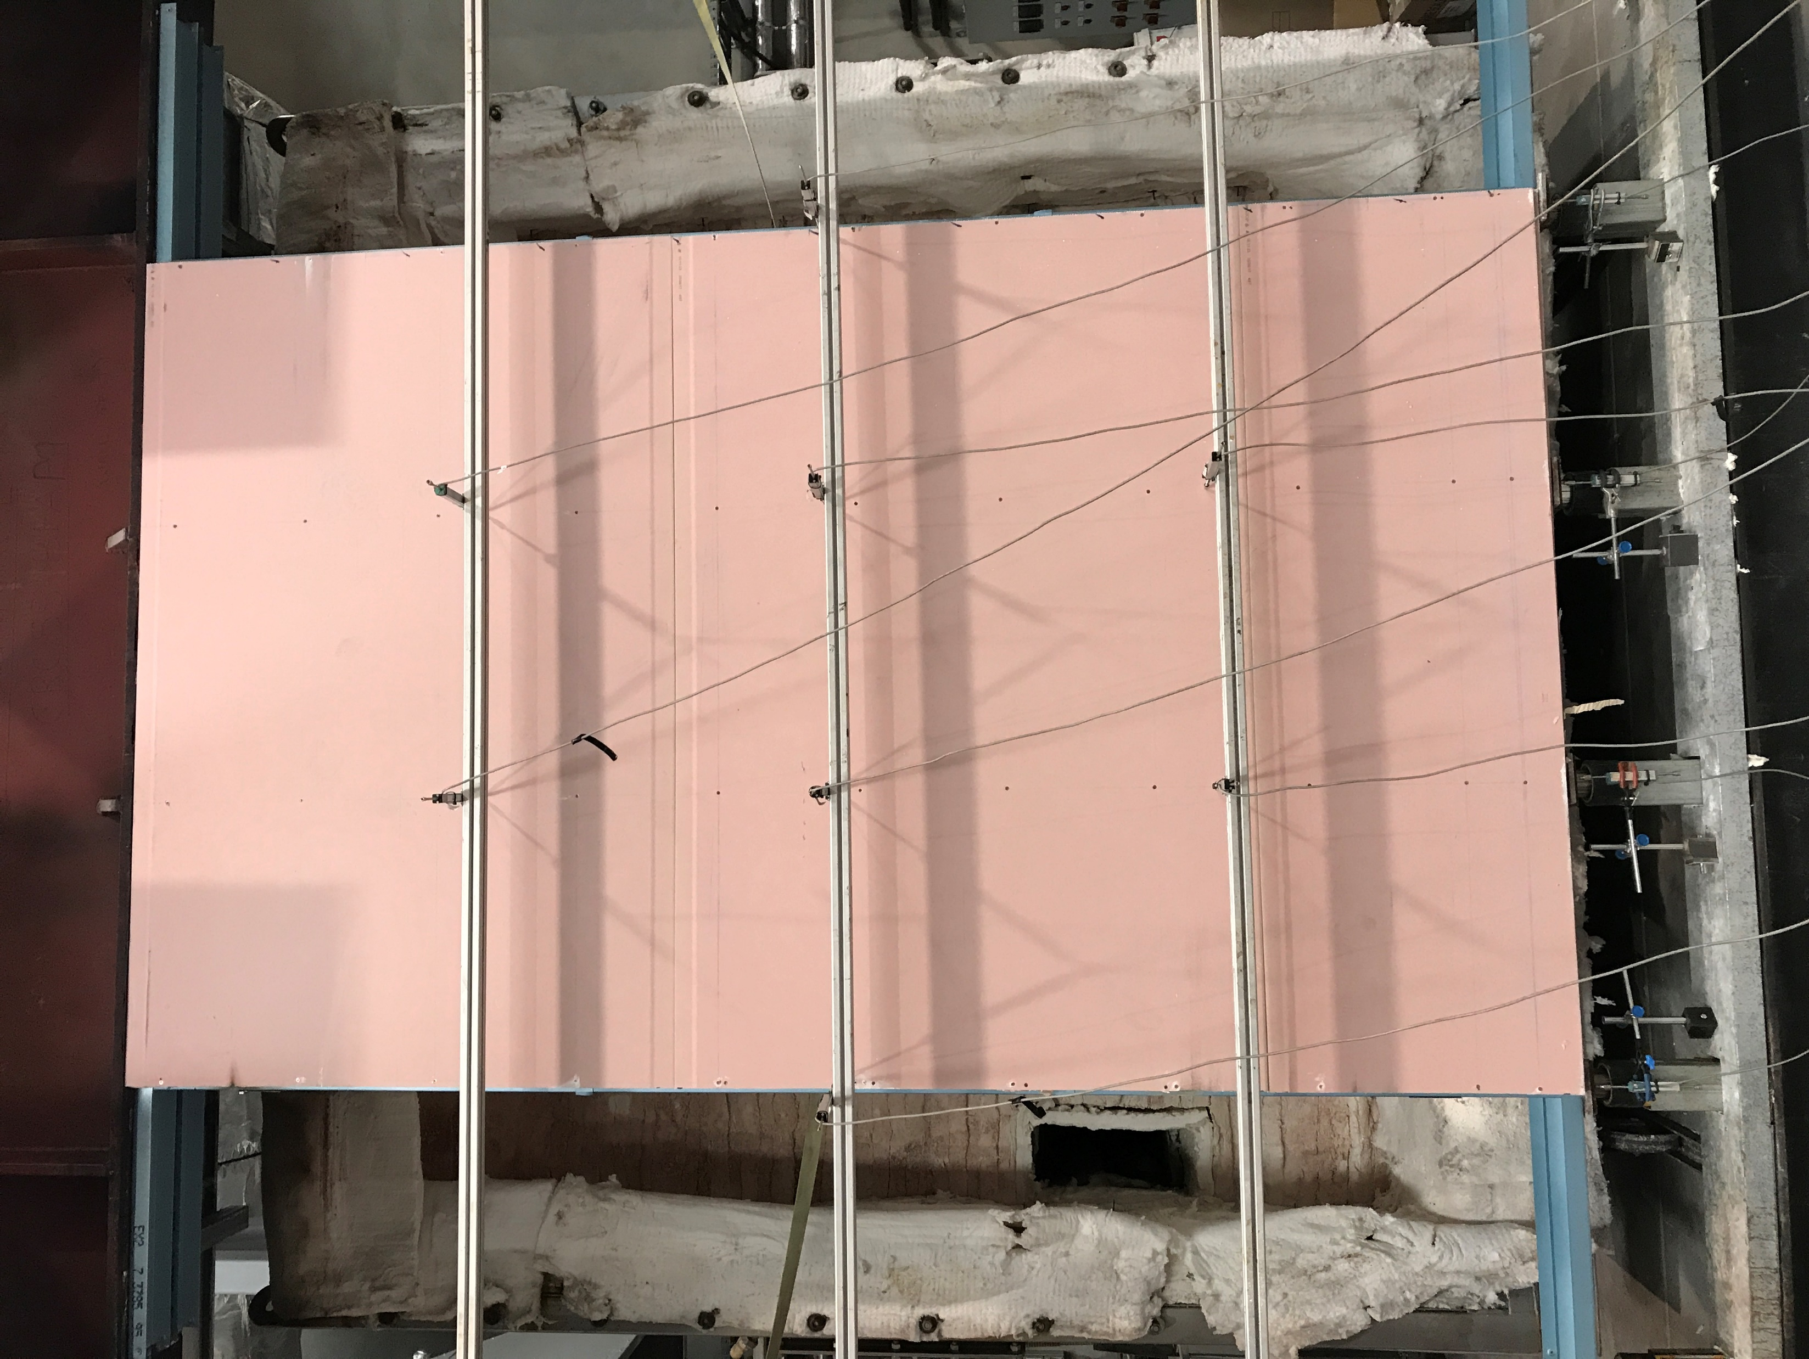
Top Beam (WB)
Top Track
Plasterboard
Lateral LVDT
Hydraulic Rams and Axial LVDT
Bottom Track
Bottom Beam (UB)

Slide 2
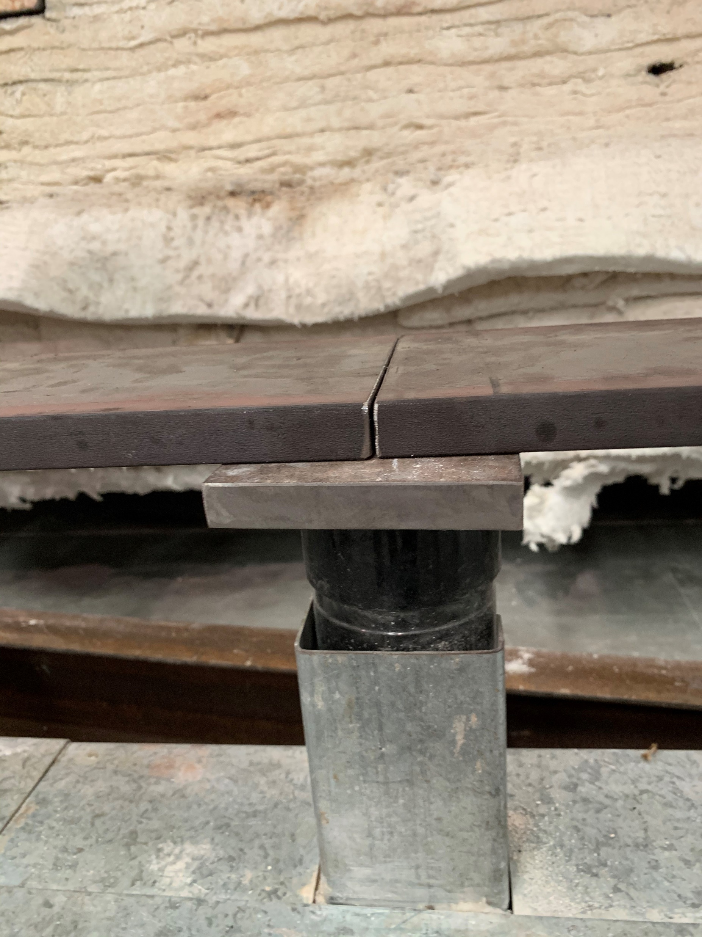
Loading plate split between rams
Bottom end plate
Hydraulic ram

Slide 3
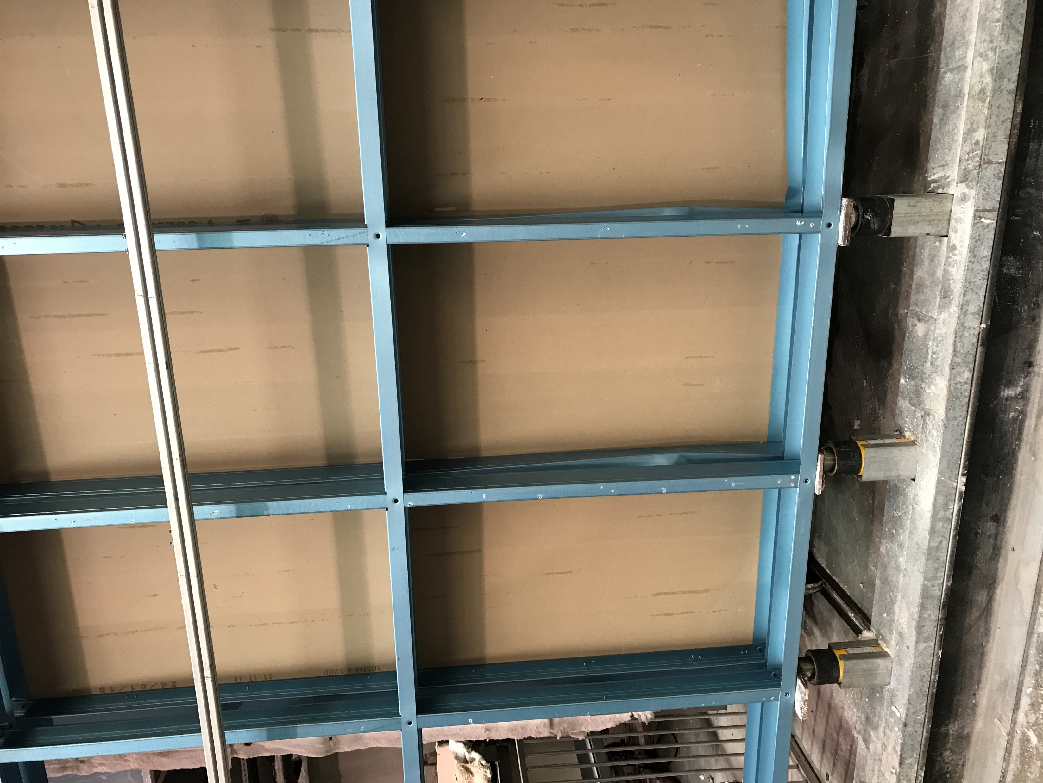
Local buckling of the flange
Notes:
AT1

Slide 4
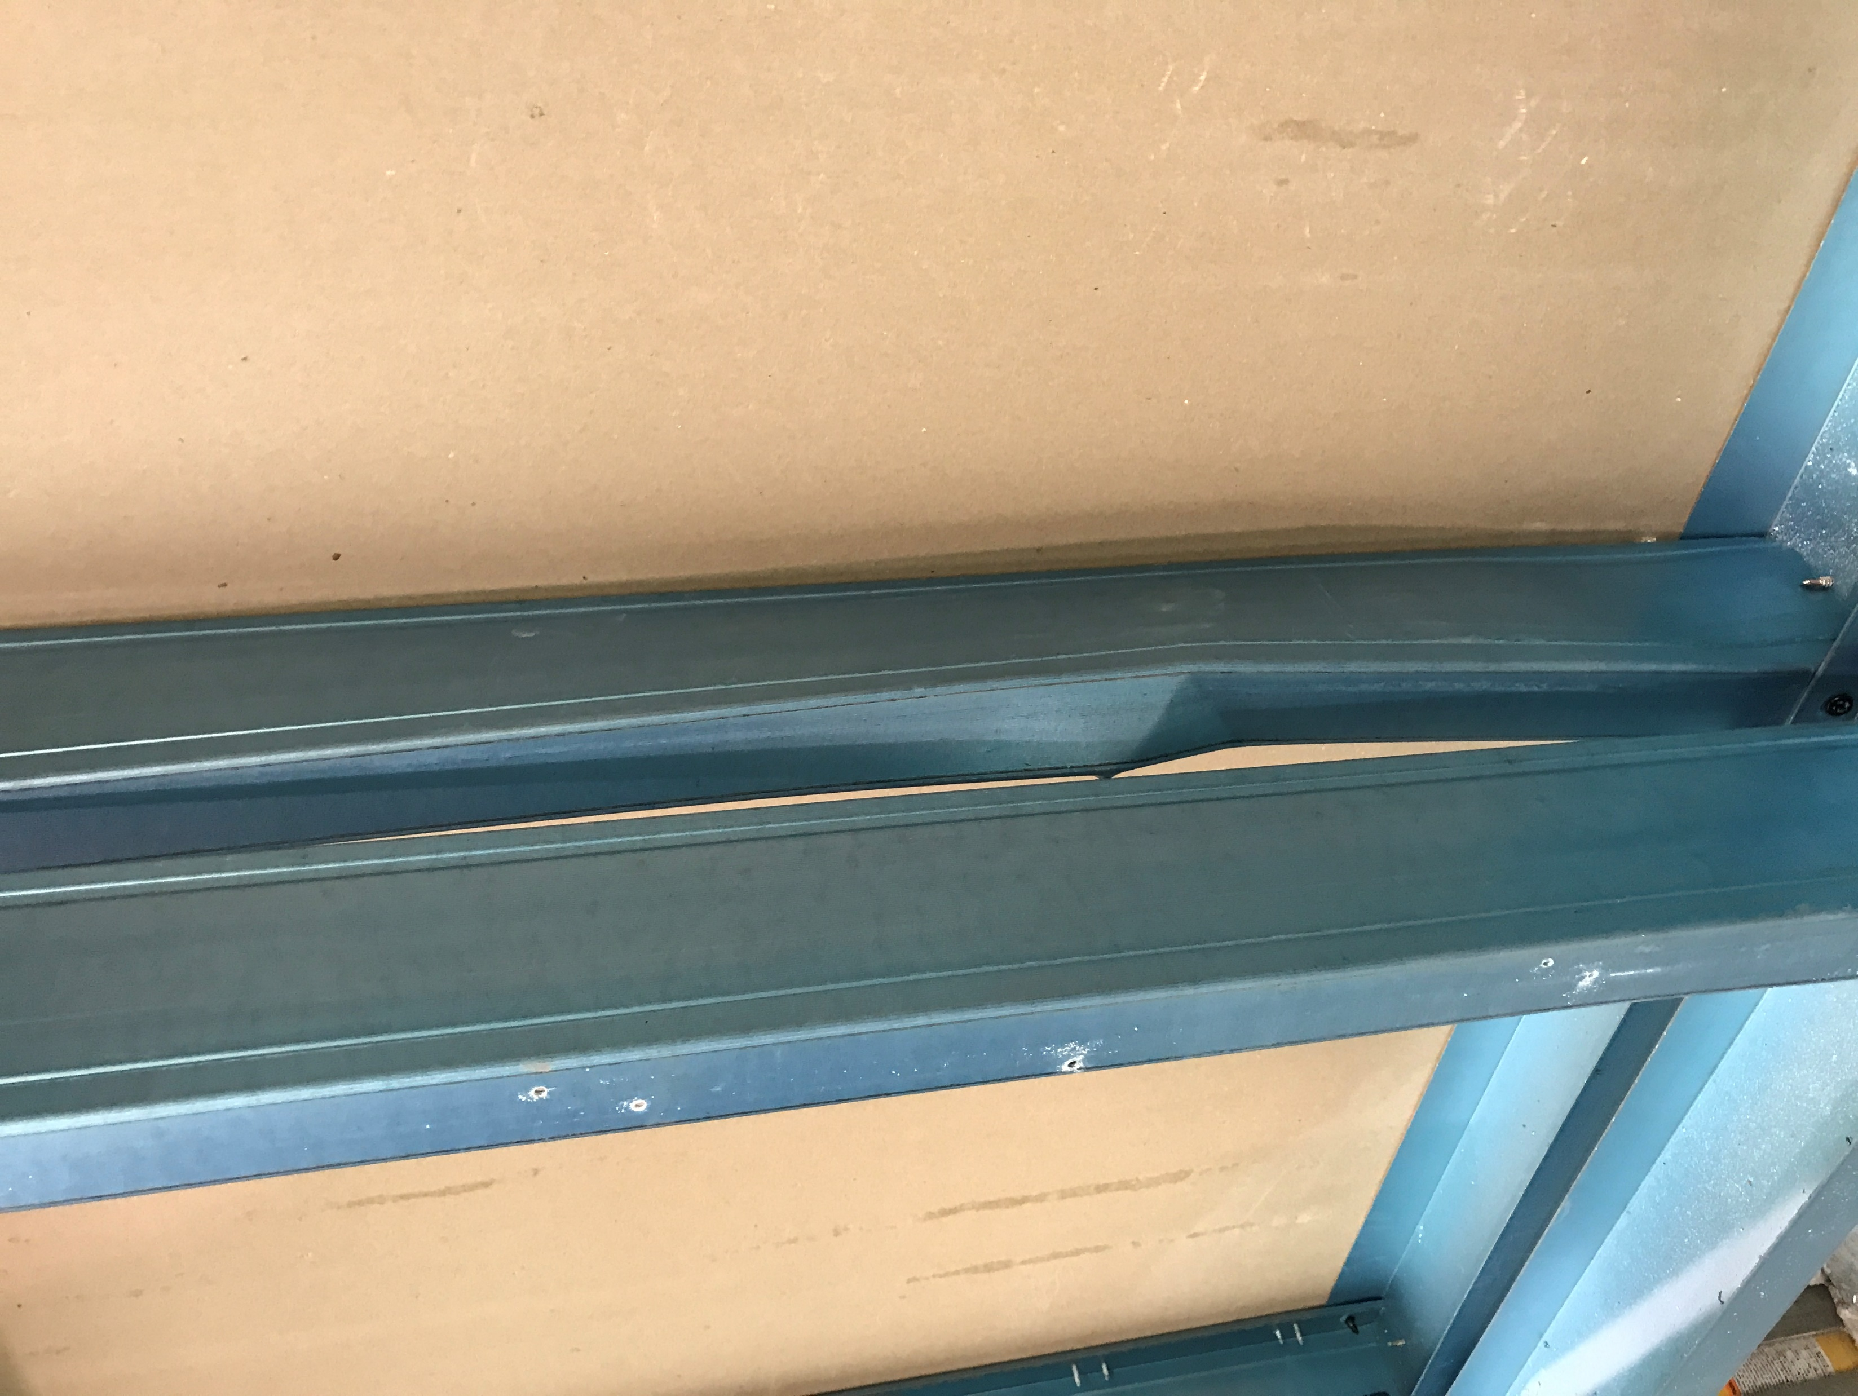
Local buckling of the flange
Notes:
AT1

Slide 5
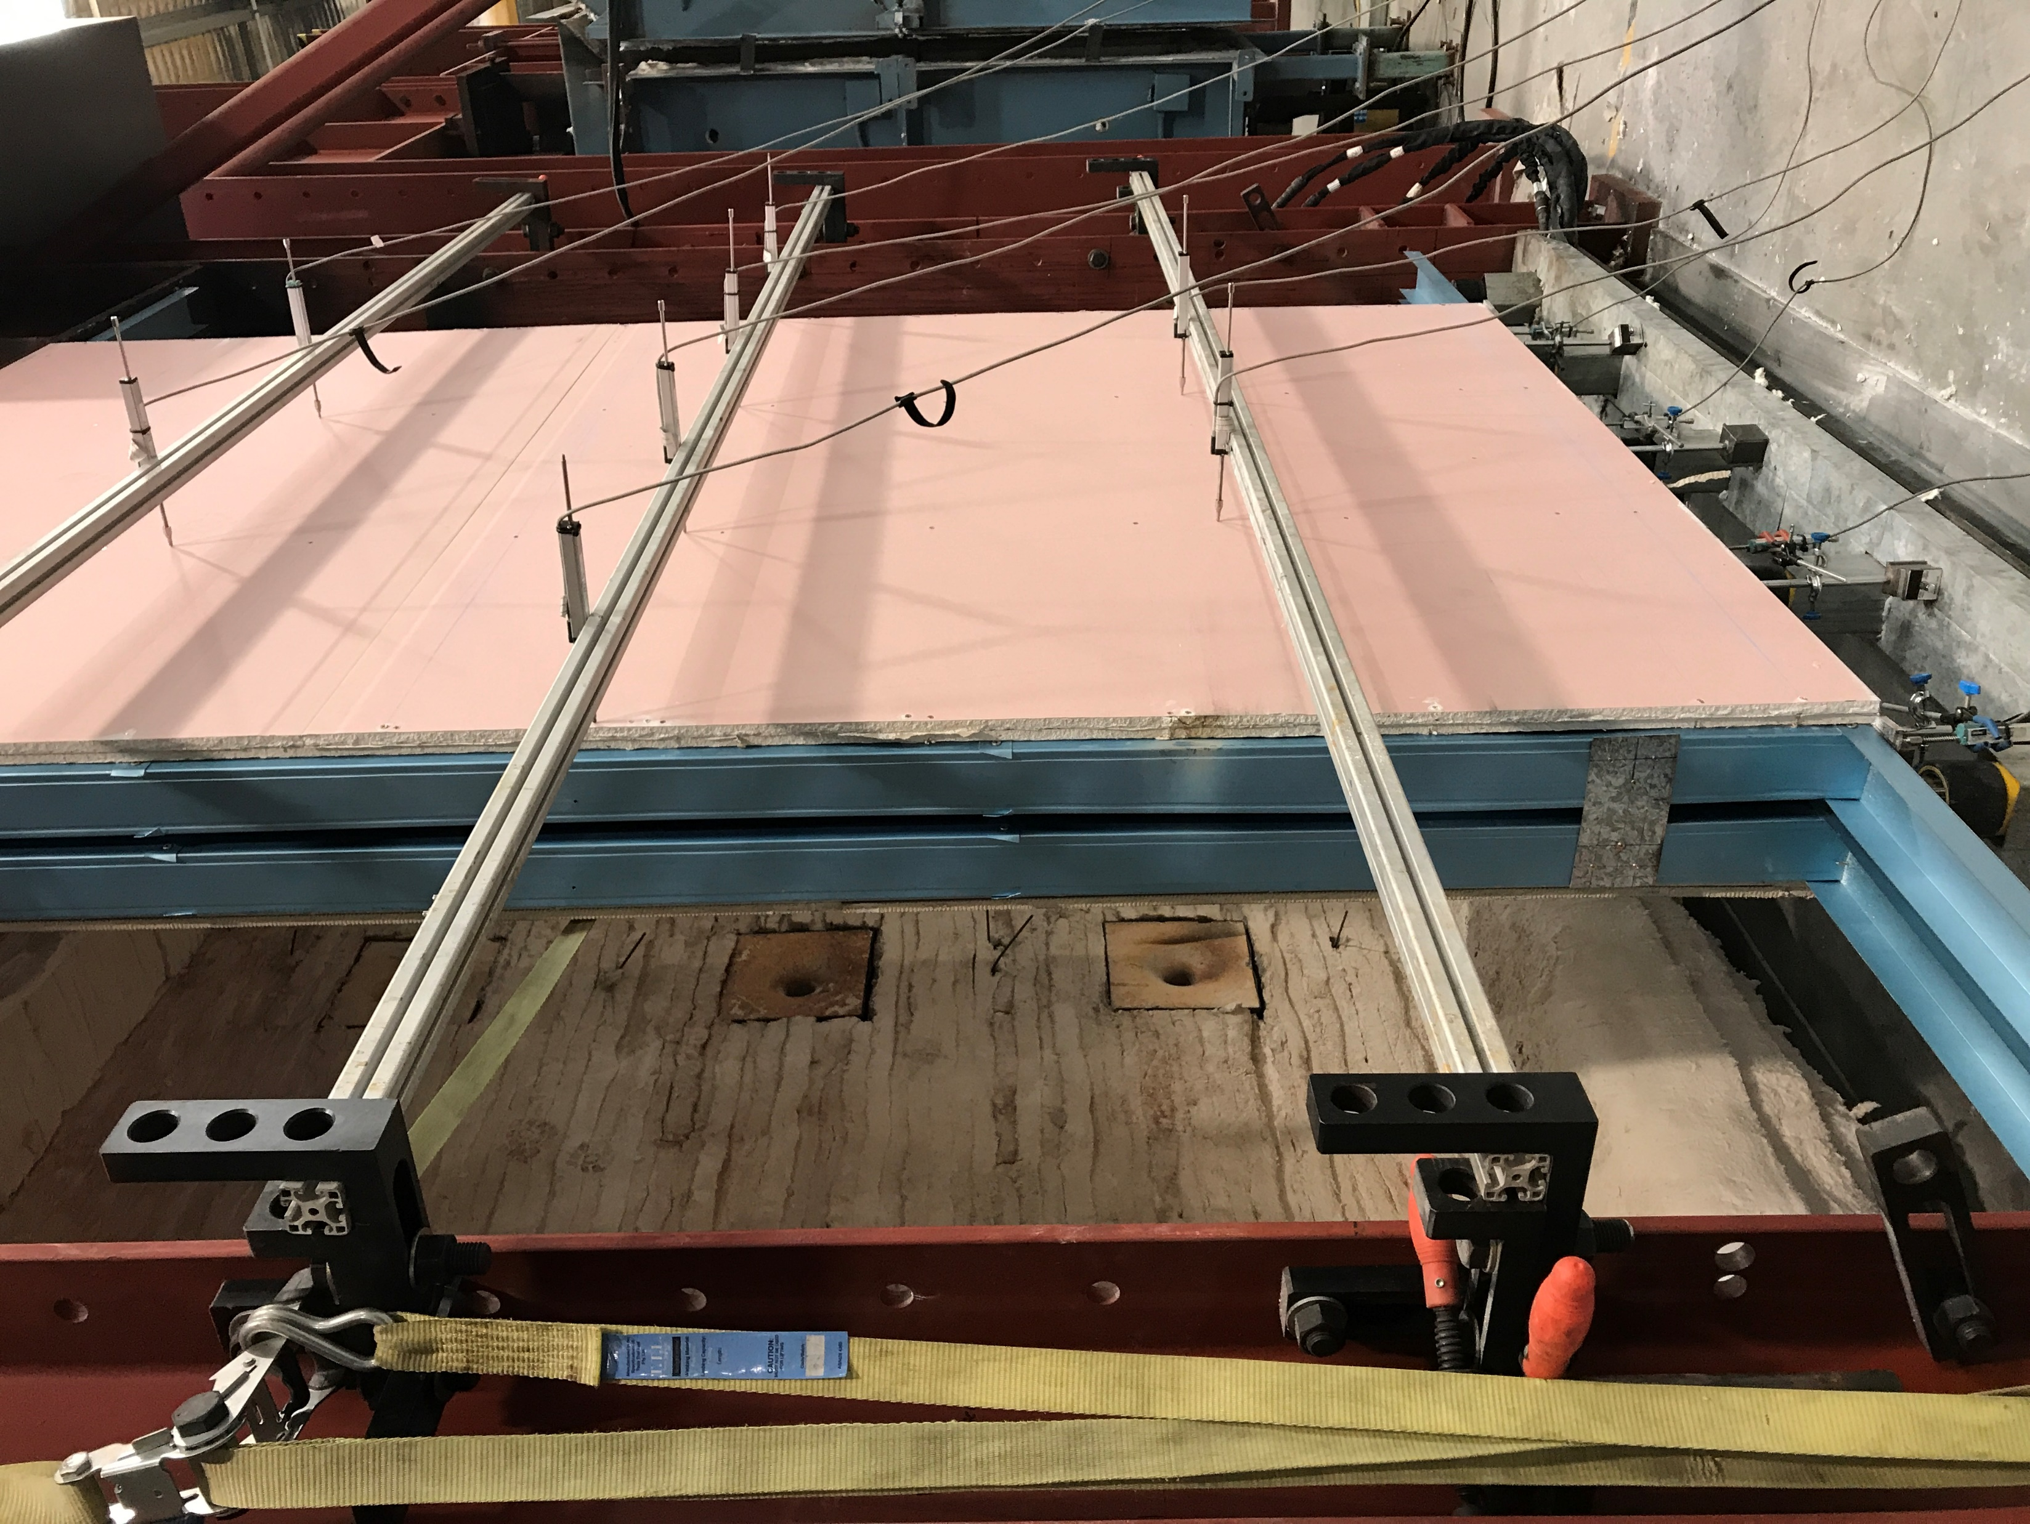
Buckling on the web during loading
Notes:
AT2

Slide 6
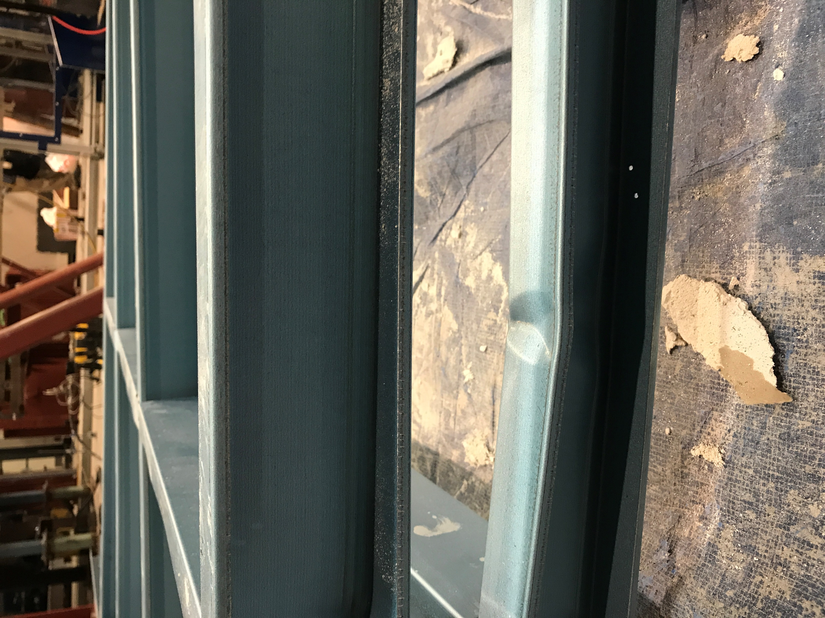
Local buckling of the flange
Notes:
AT2

Slide 7
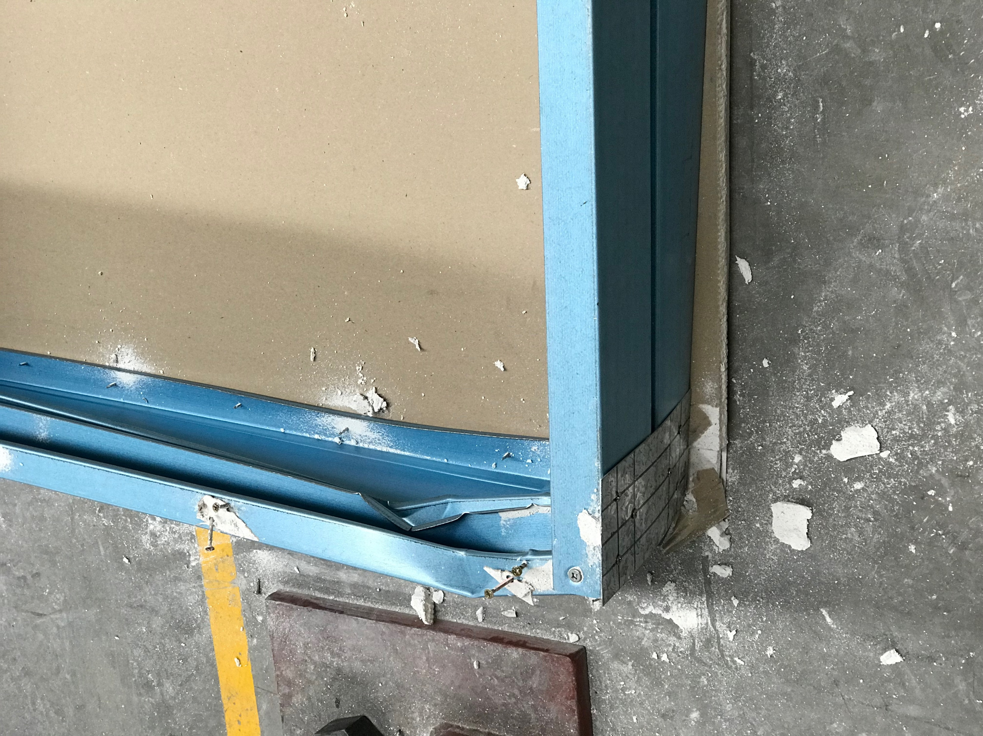
Local crushing in edge stud
Notes:
AT3

Slide 8
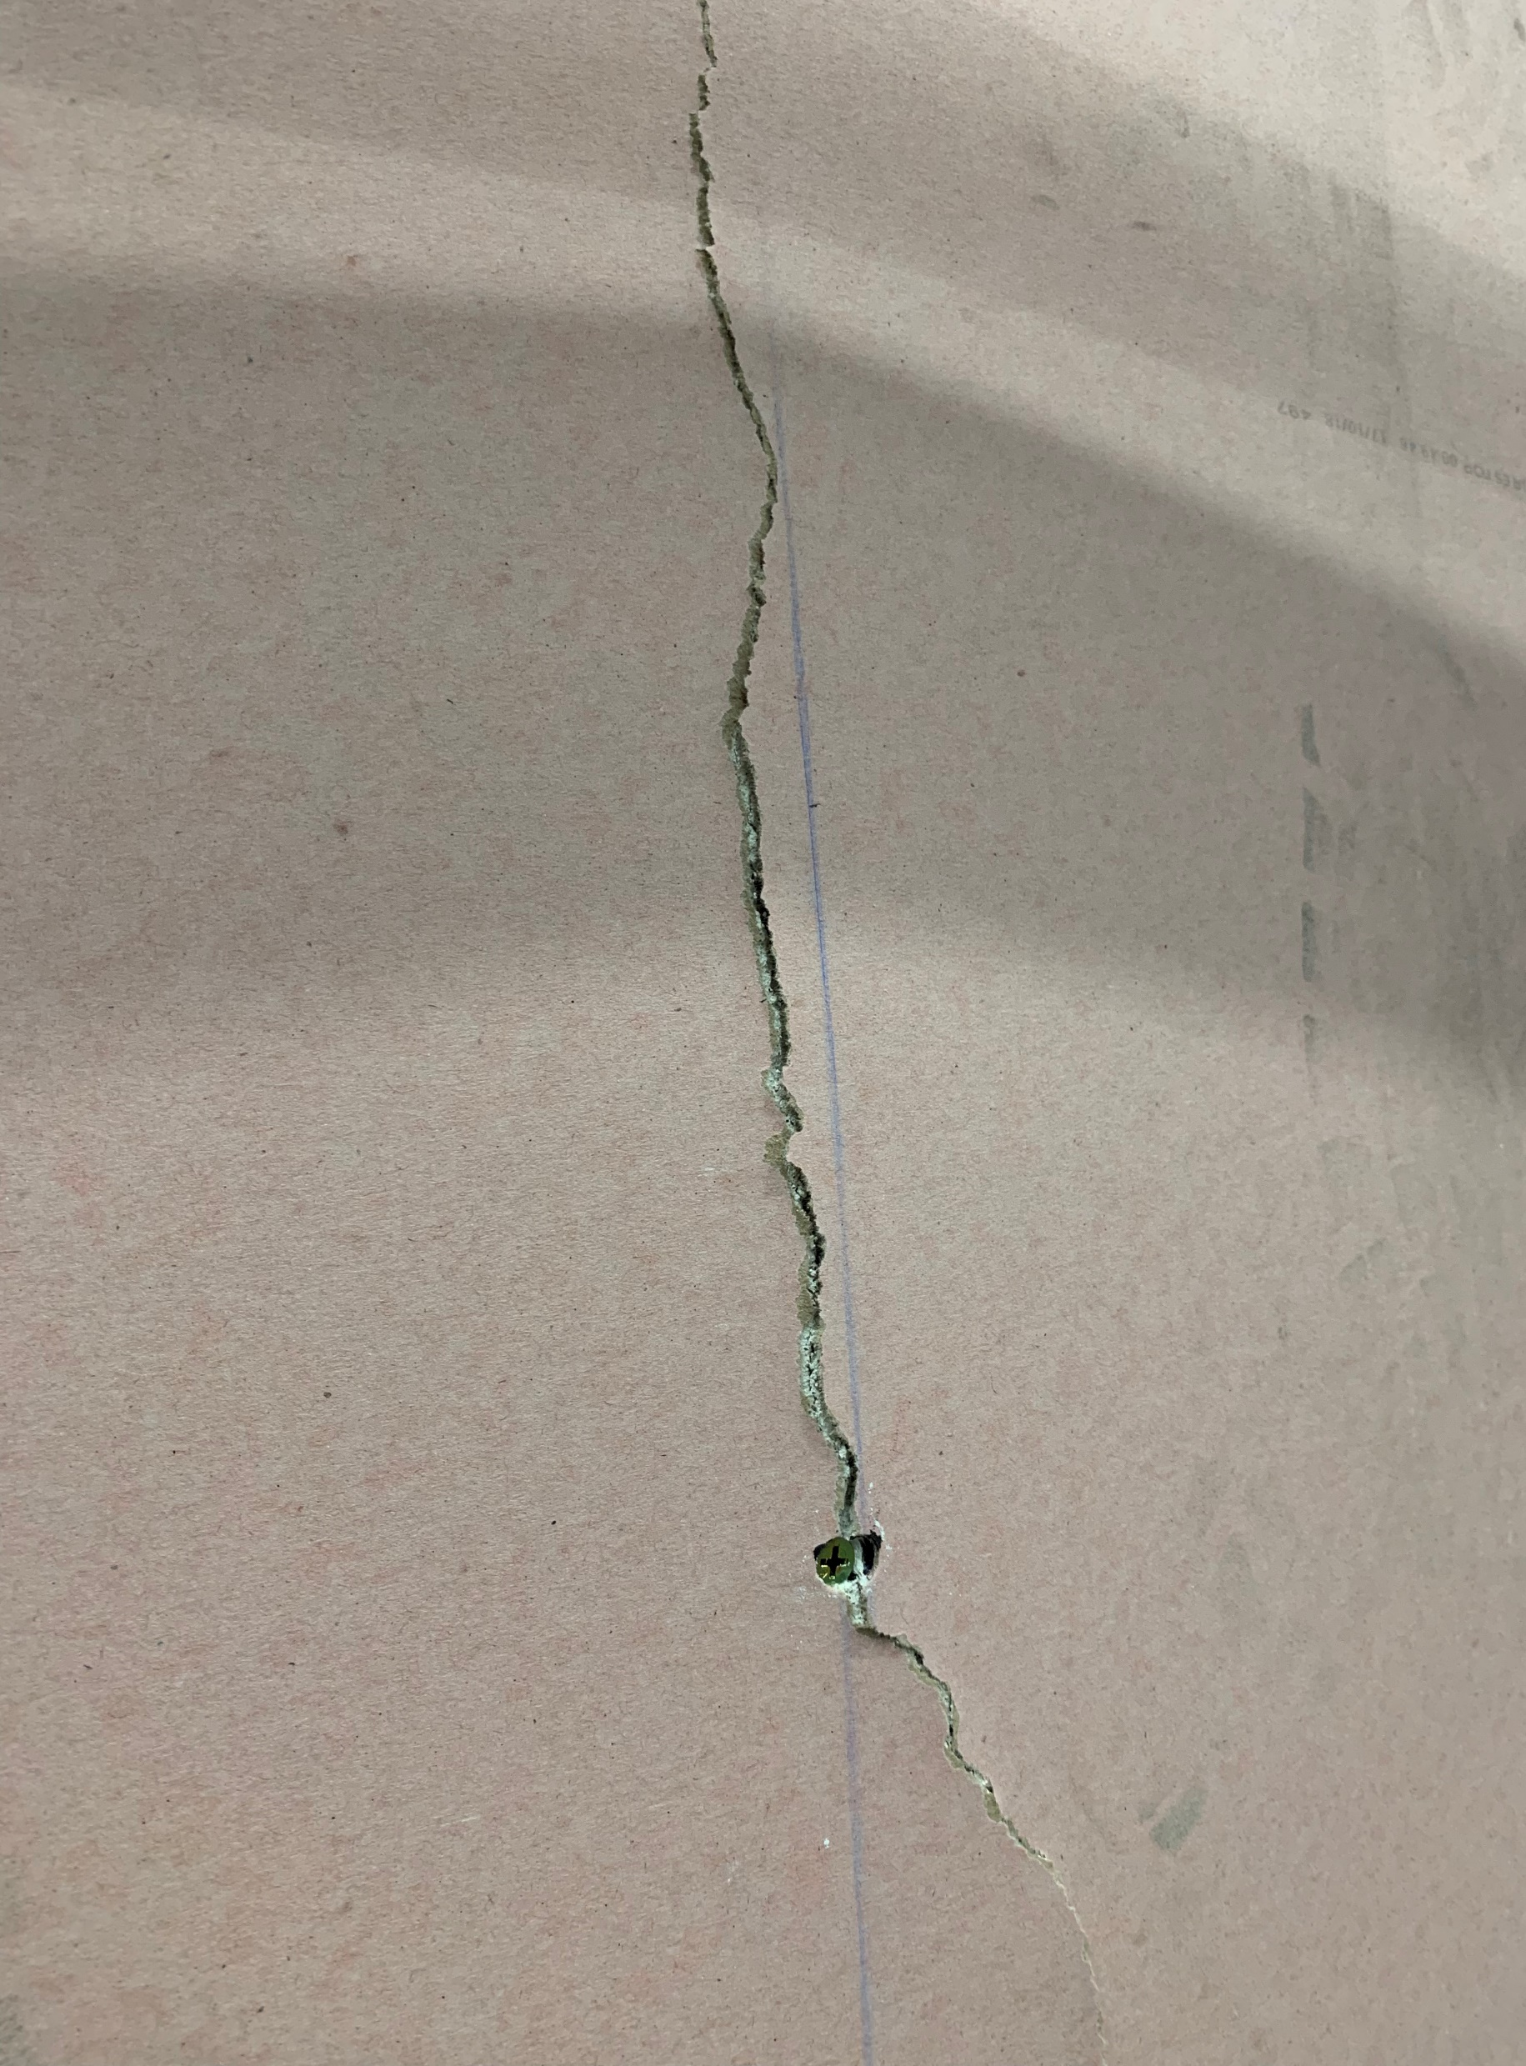
Crack on ambient side plasterboard at Stud3
Notes:
AT4

Slide 9
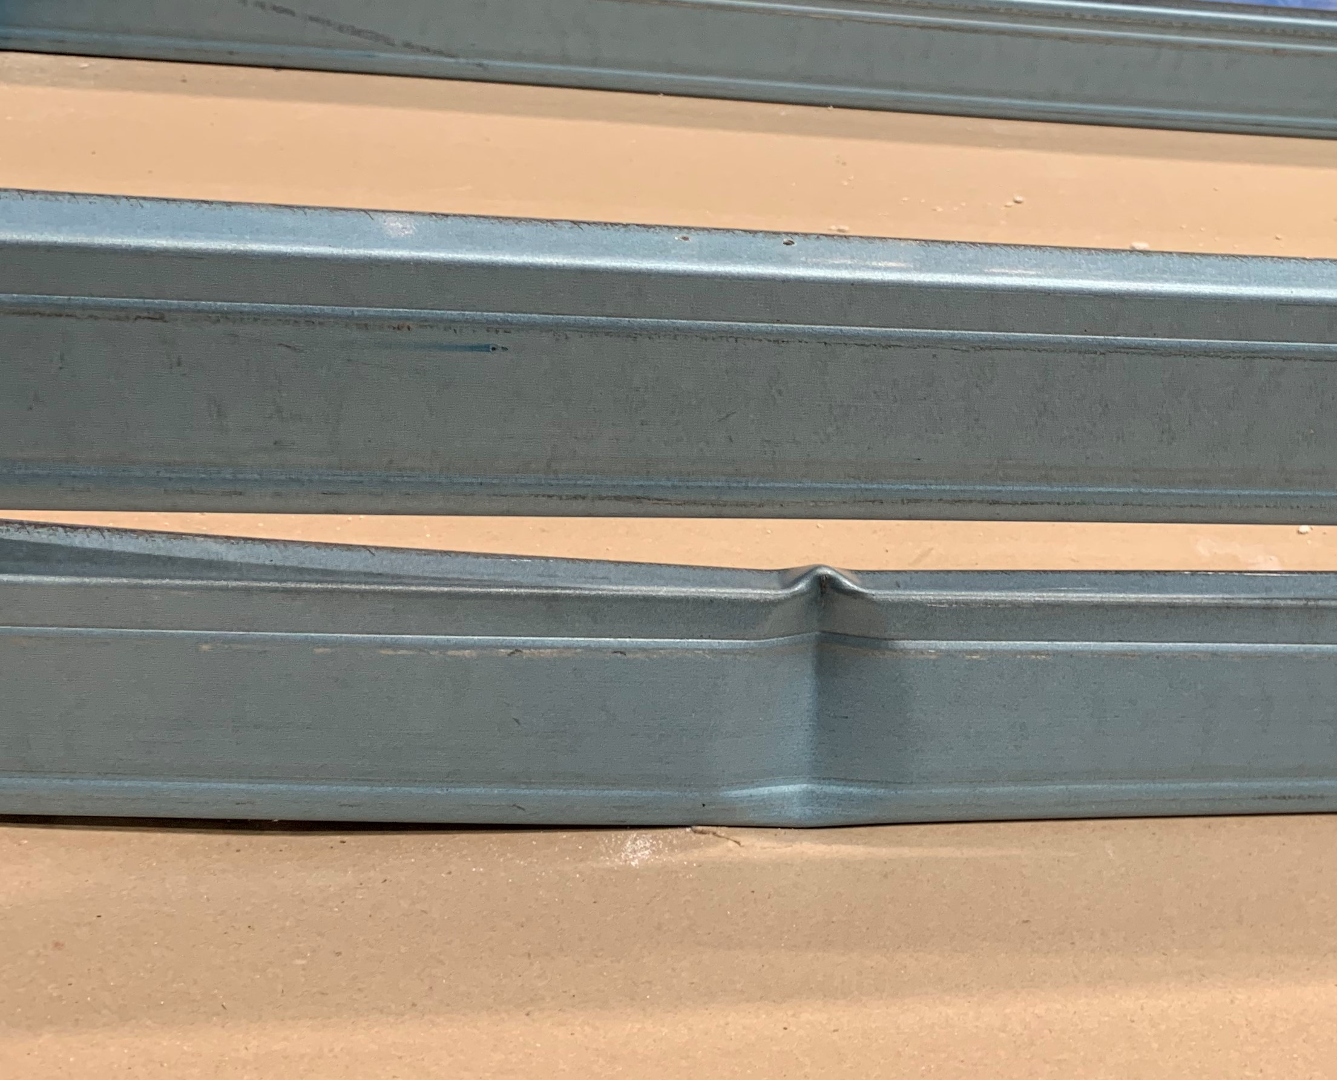
Buckling of web and flanges in Stud3
Notes:
AT4

Slide 10
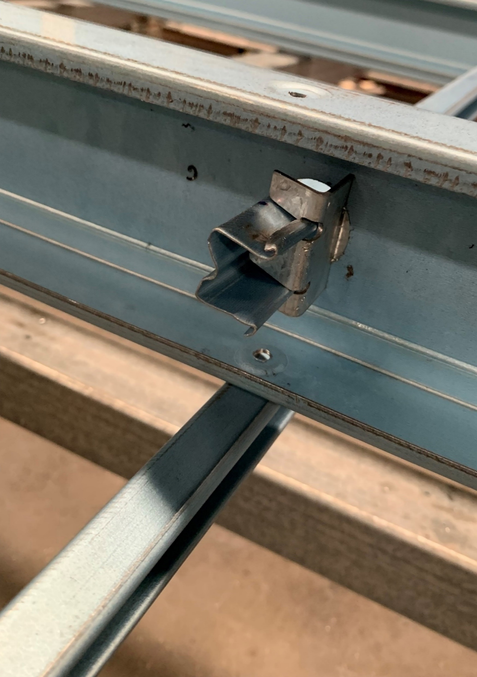
Omega nogging
Service hole
Connecting clip
Notes:
AT5-connection

Slide 11
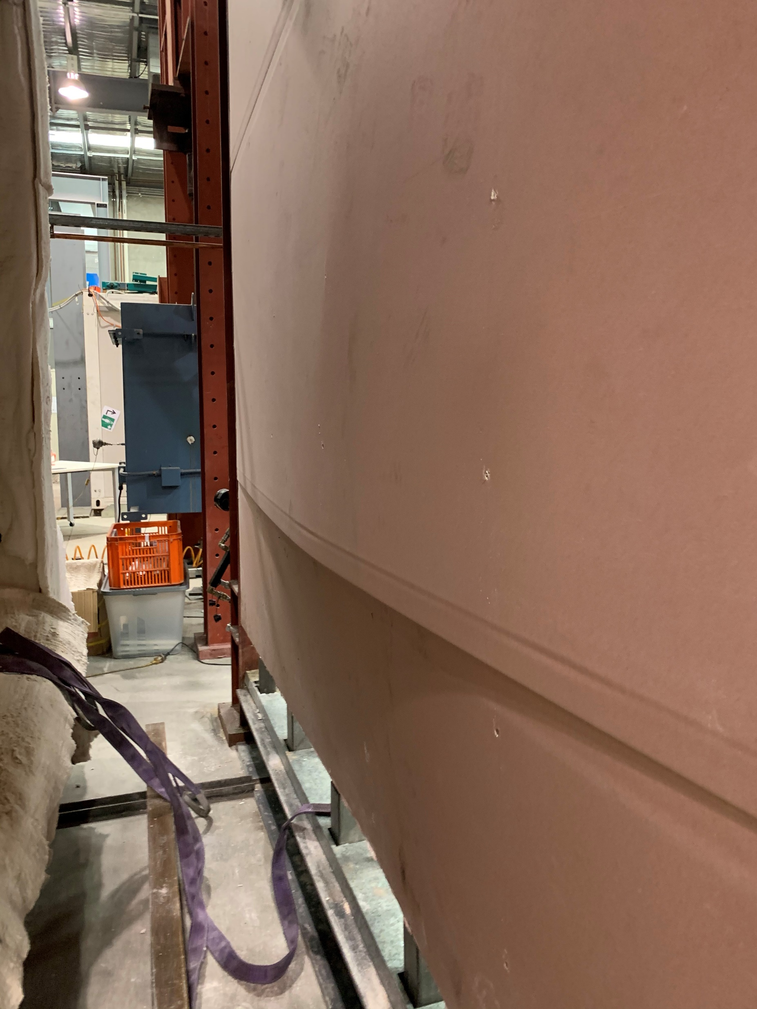
Plasterboard open up
Notes:
AT5-plasterboard

Slide 12
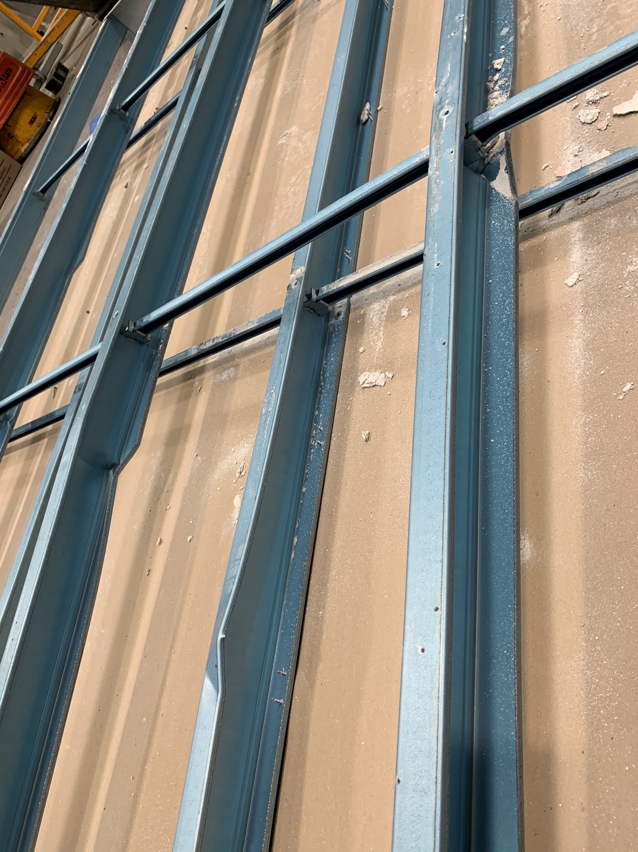
Buckling of flanges and web
Buckling of flange

Slide 13
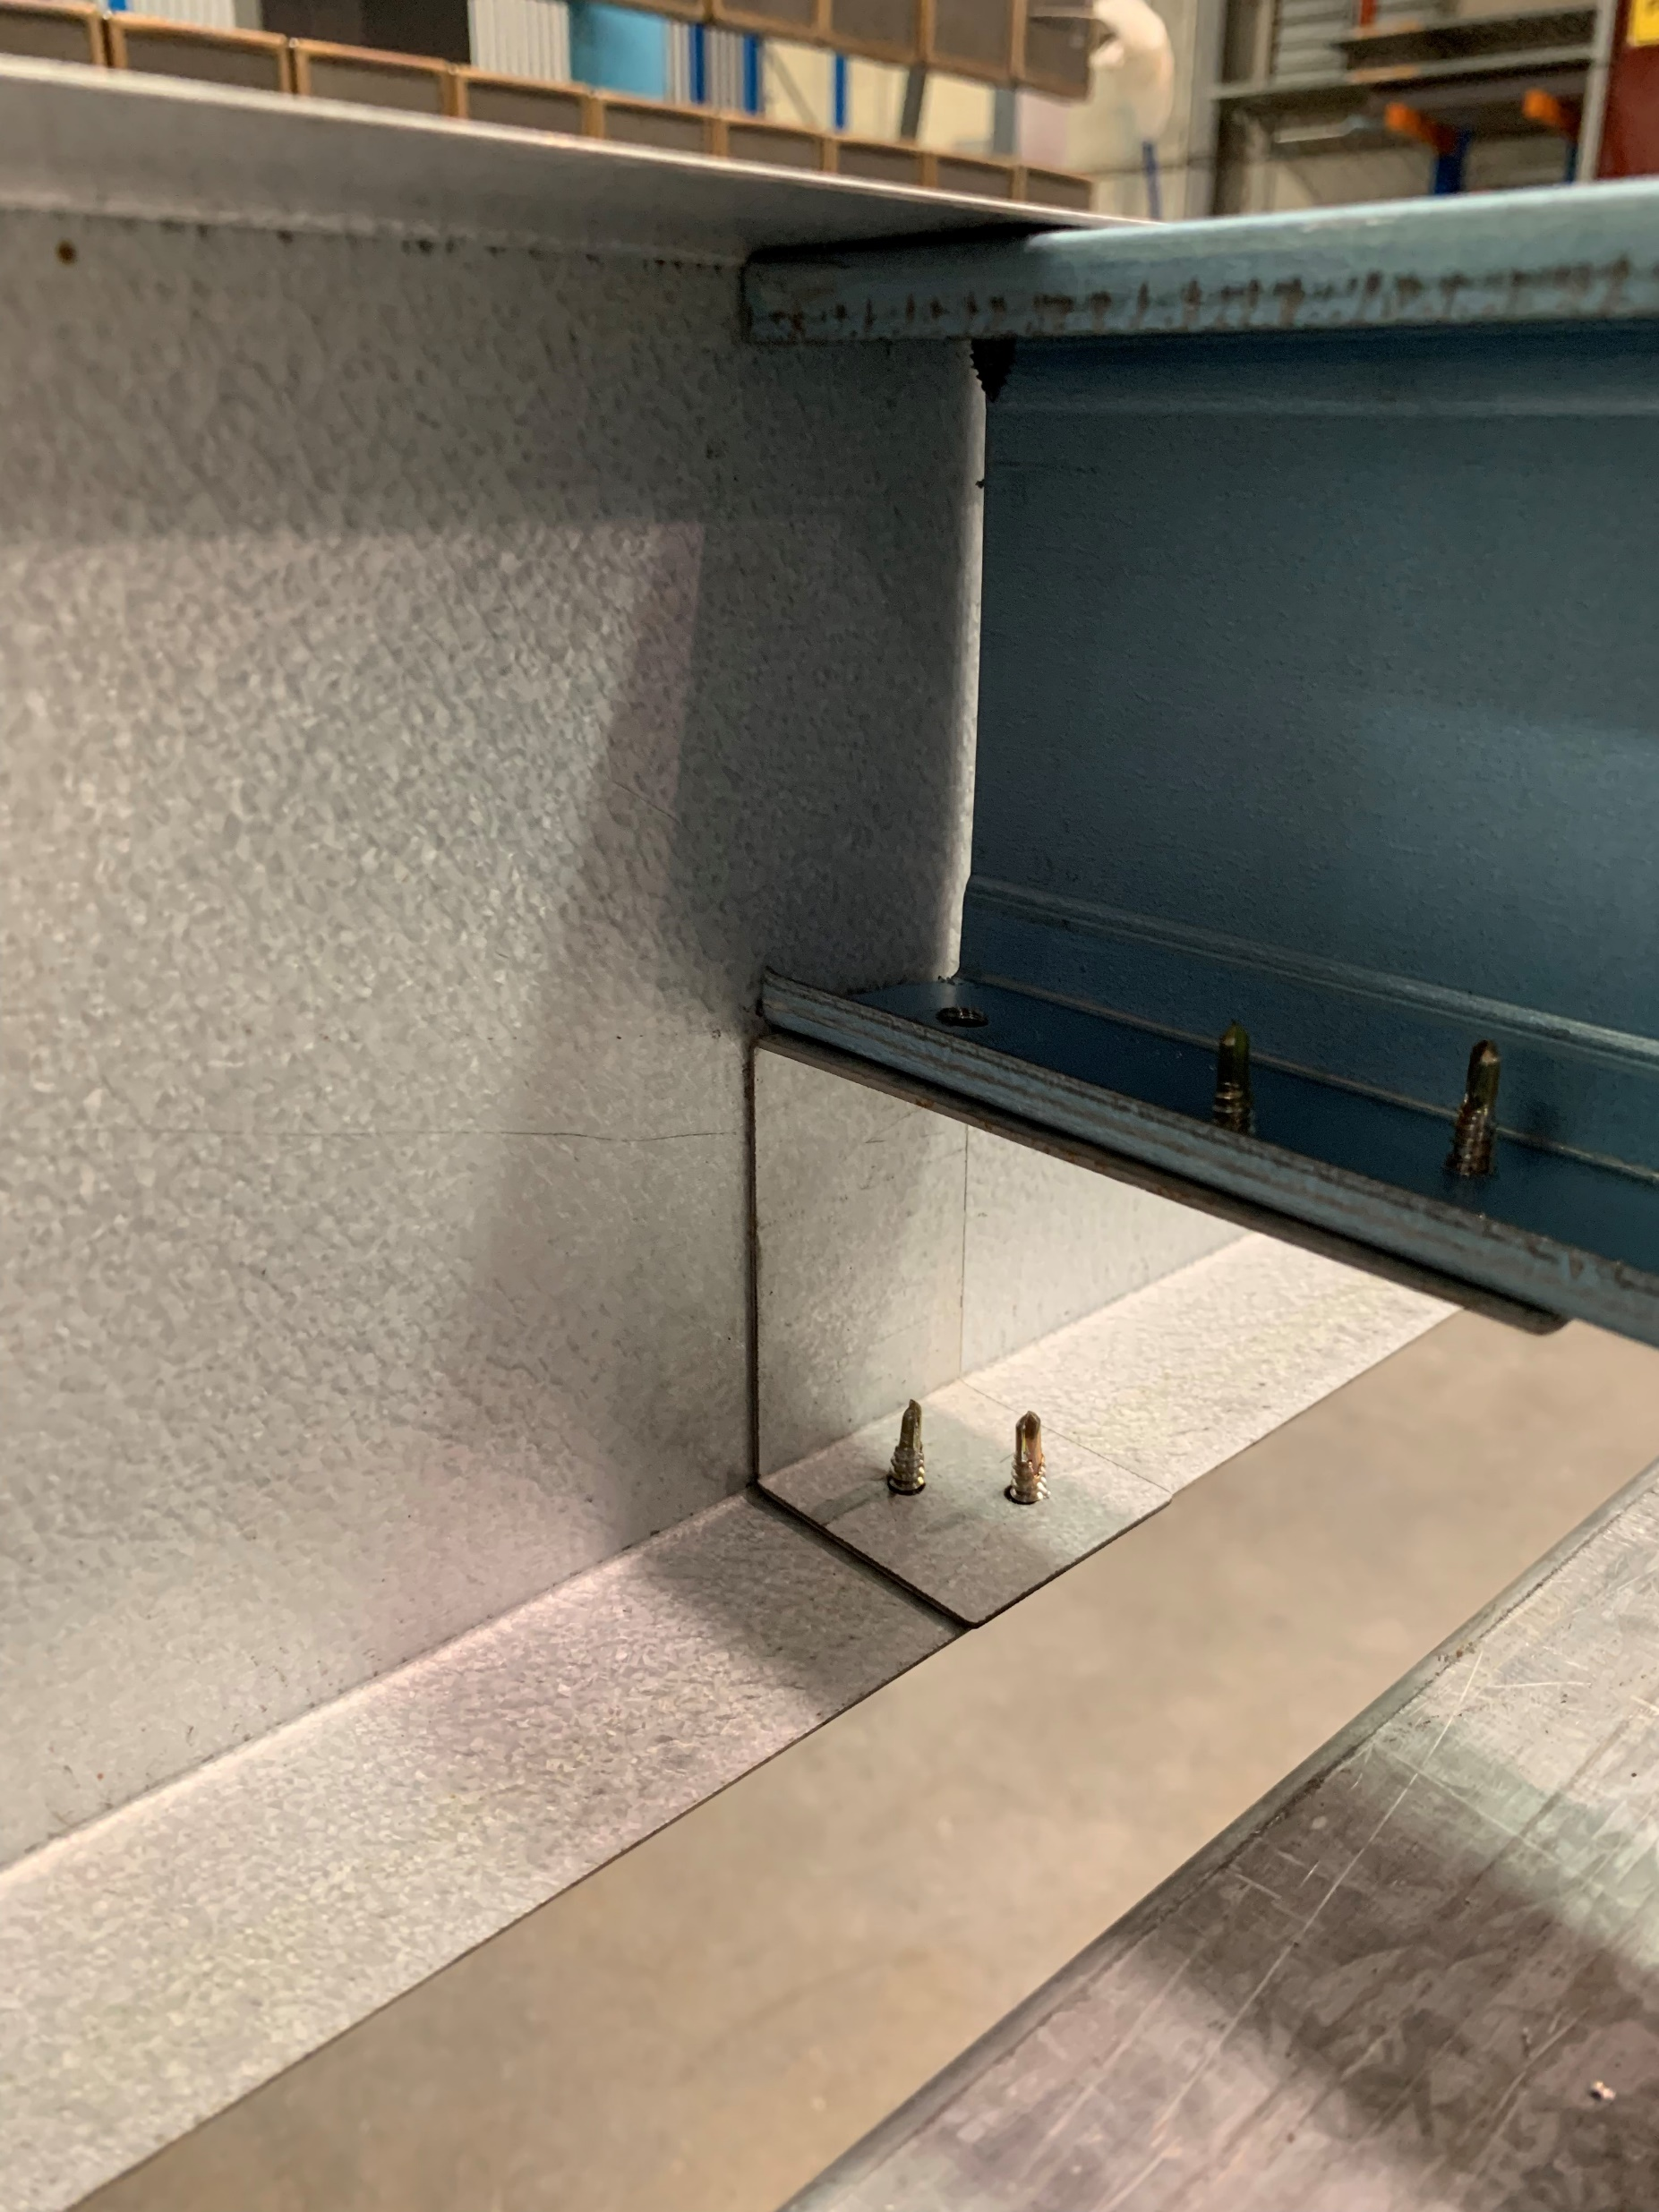
Stud flange
Stud web
Track
End cleat
Stud flange
Track flange

Slide 14
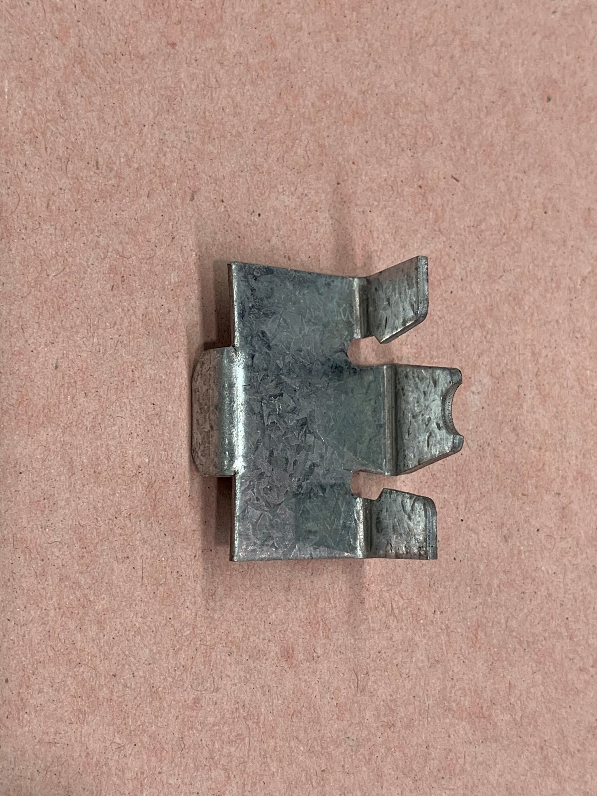
Groove to attach on service hole
Clip arms
400 mm
200 mm

Slide 15
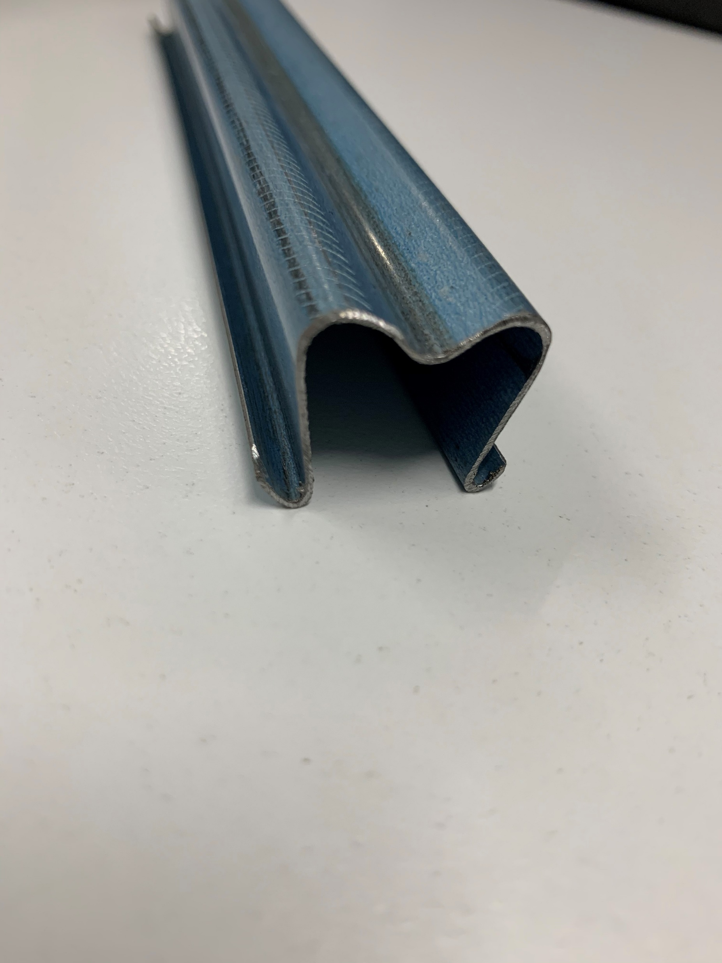
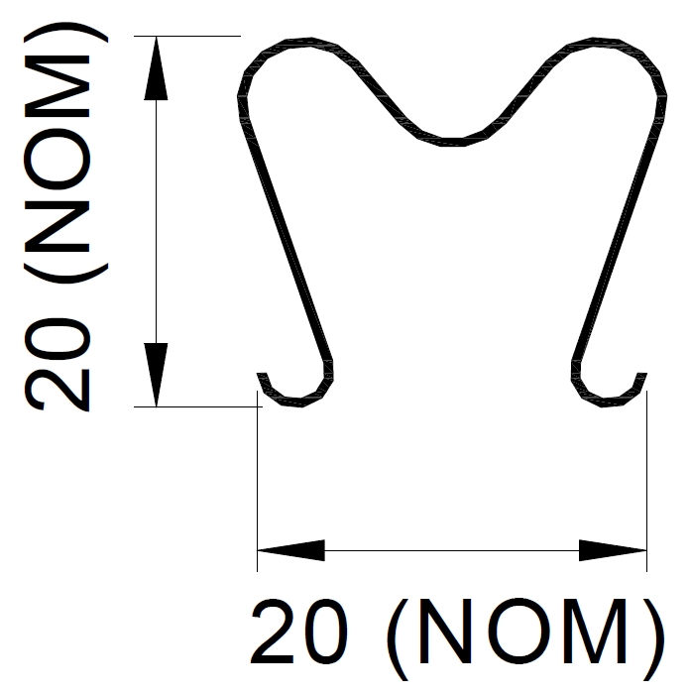

Slide 16
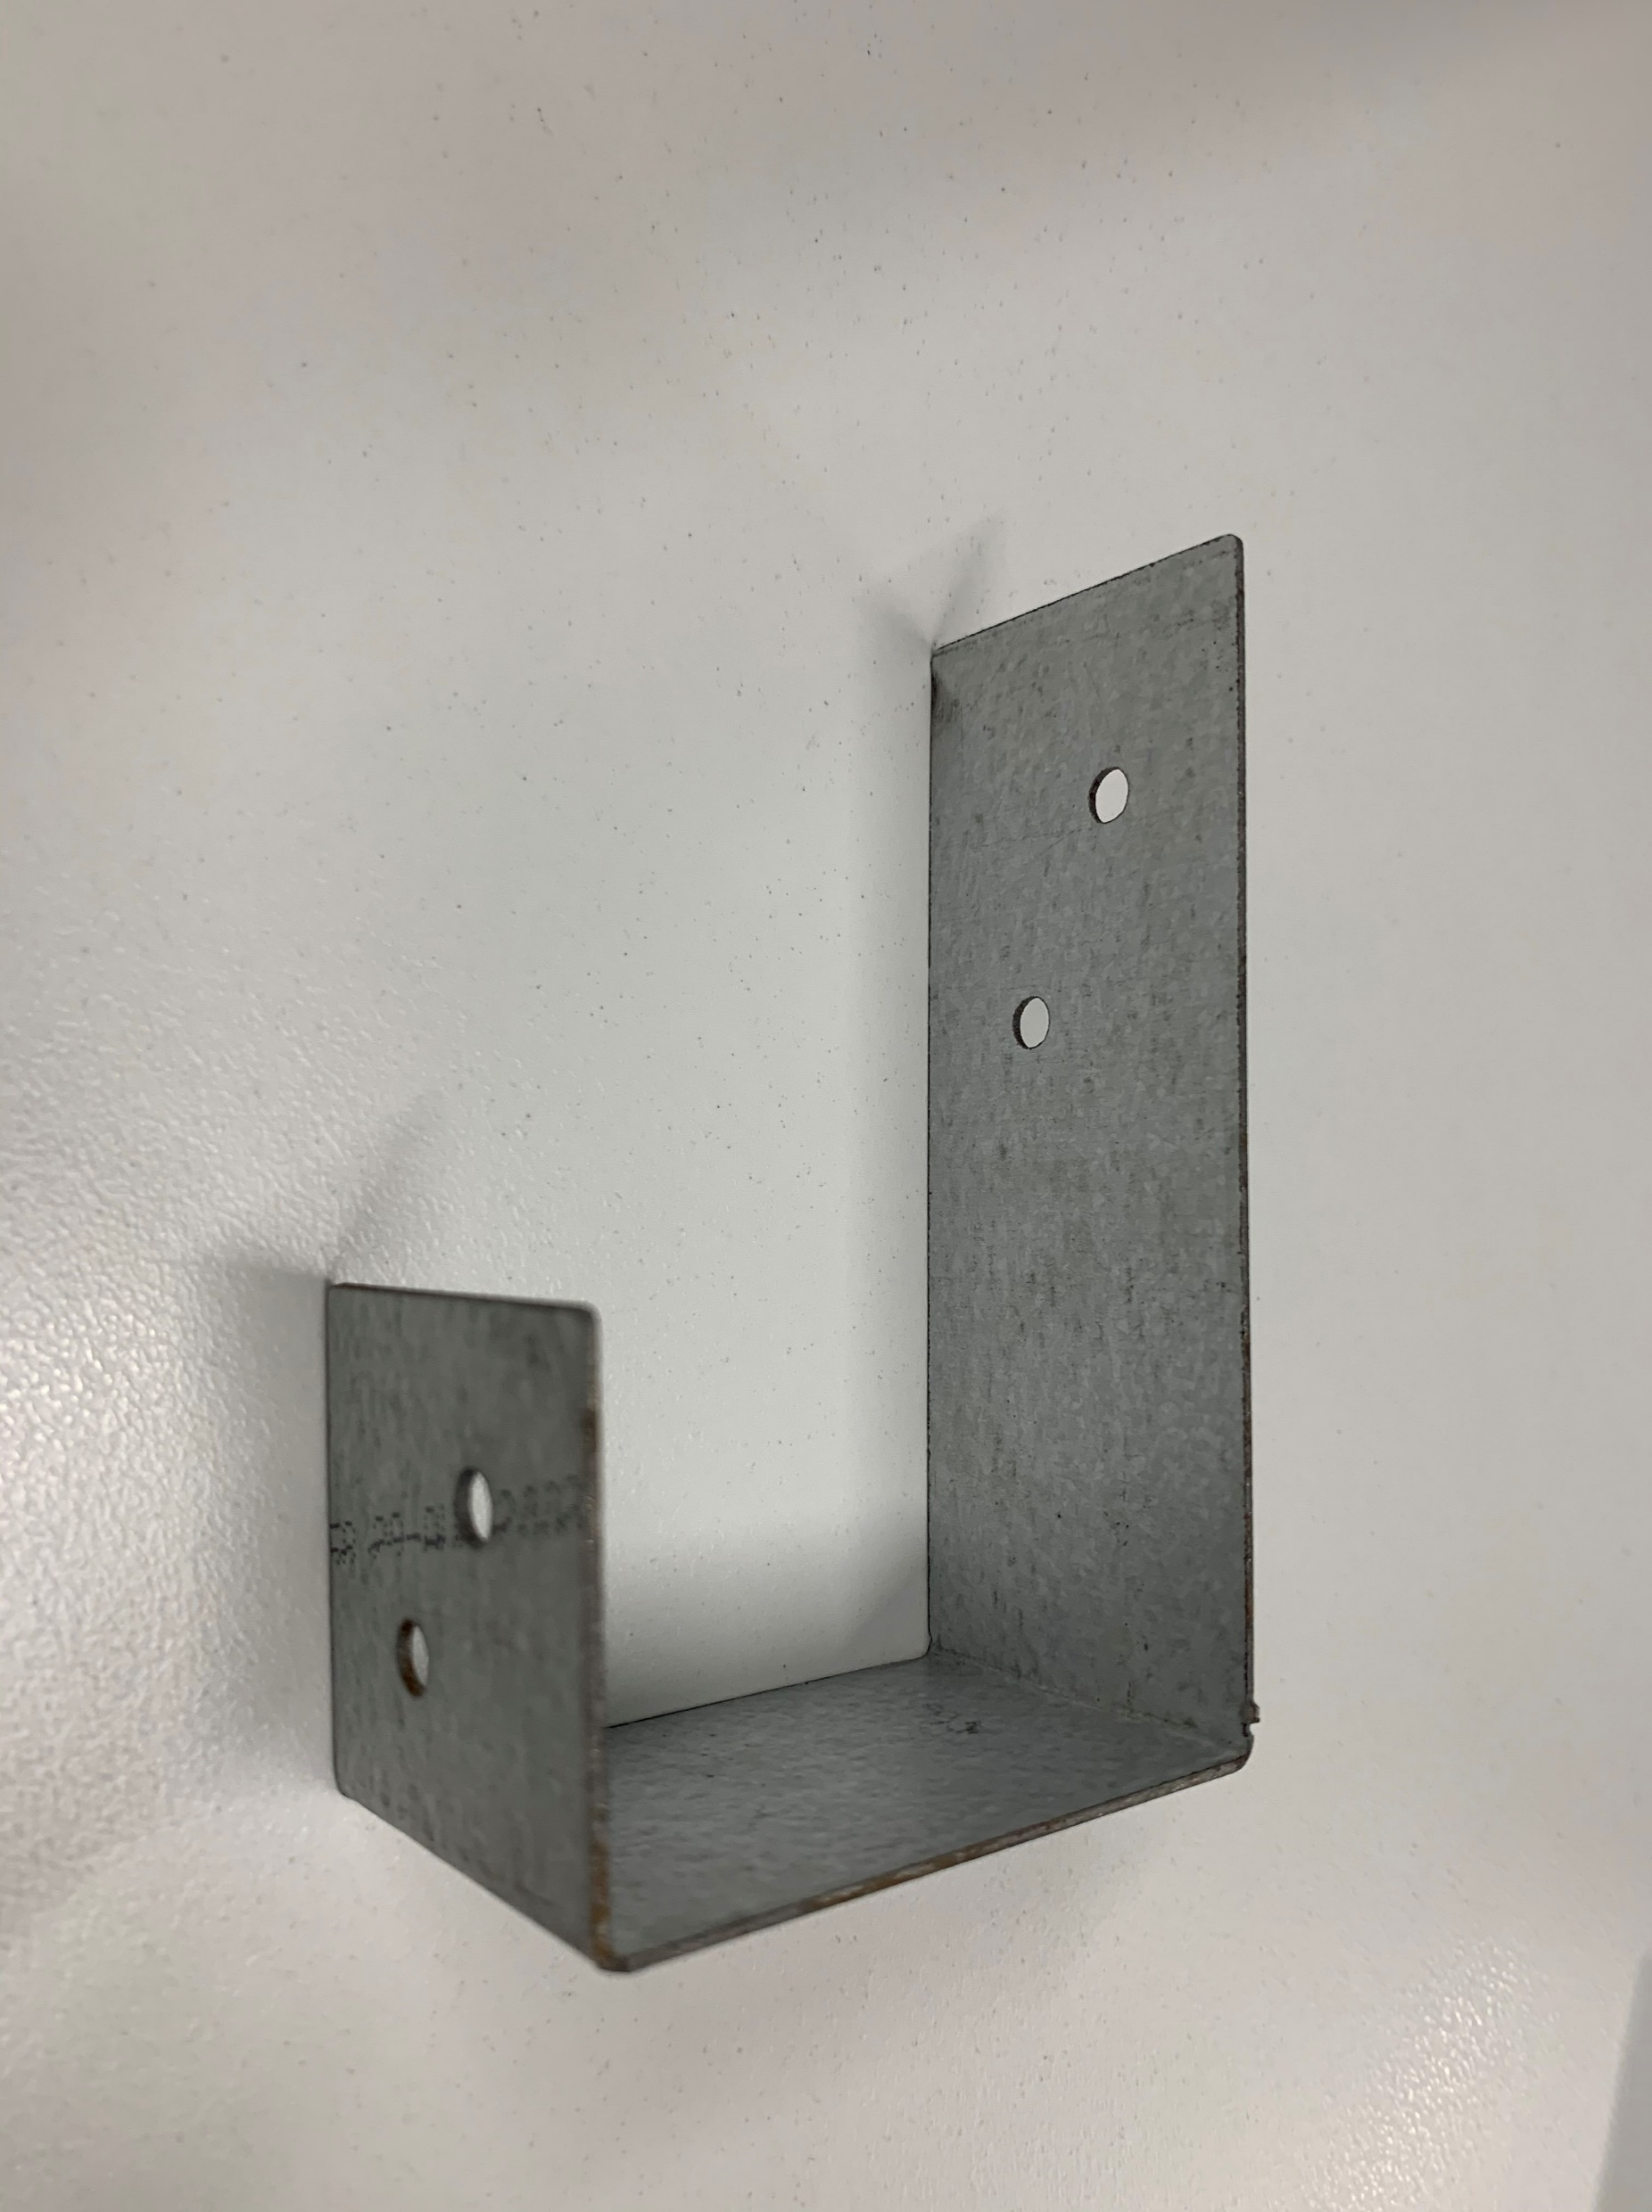
40 mm
100 mm
61 mm

